Slide 1


Story_Assistant
file:///D:/Github/TestPage/Test.html
Alice in wonder land
Harry Potter
Feb, 9, 2017 10:00 PM
Feb, 9, 2017 10:00 PM

Slide 2
Story_Assistant
file:///D:/Github/TestPage/Test.html
New Story
Alice in wonder land
Harry Potter
Feb, 9, 2017 10:00 PM
Feb, 9, 2017 10:00 PM

Slide 3
Story_Assistant
file:///D:/Github/TestPage/Test.html
New Story
Create
Alice in wonder land
Harry Potter
Import
Feb, 9, 2017 10:00 PM
Feb, 9, 2017 10:00 PM

Slide 4
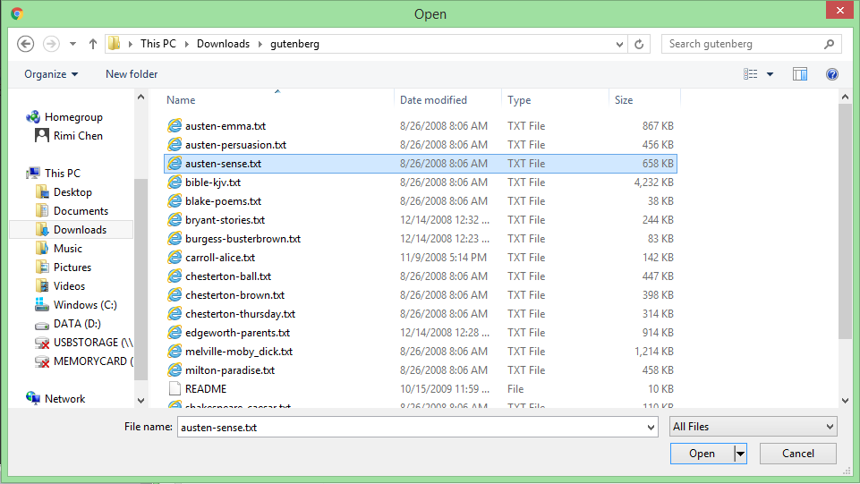
Story_Assistant
file:///D:/Github/TestPage/Test.html
New Story
Create
Alice in wonder land
Harry Potter
Import
Feb, 9, 2017 10:00 PM
Feb, 9, 2017 10:00 PM

Slide 5
Story_Assistant
file:///D:/Github/TestPage/Test.html
Alice in wonder land
Harry Potter
Sense
Feb, 9, 2017 10:00 PM
Feb, 10, 2017 12:00 PM
Feb, 11, 2017 10:00 PM

Slide 6





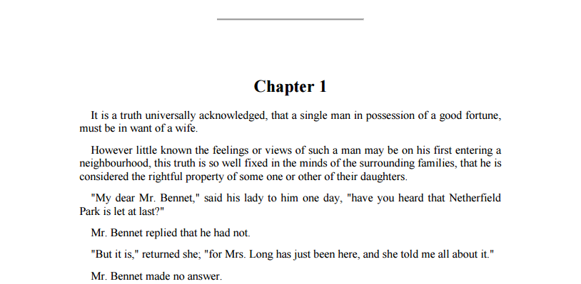
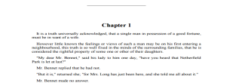
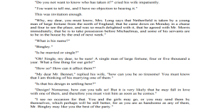
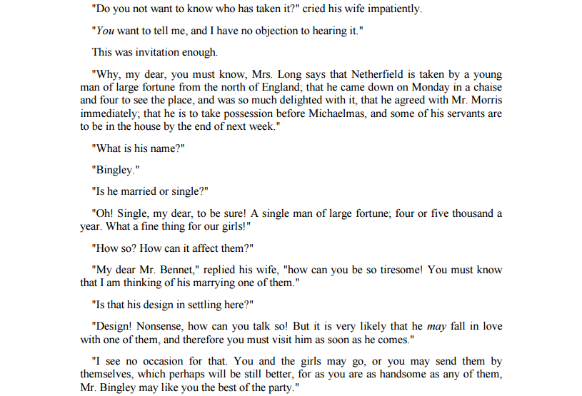
Story_Assistant
file:///D:/Github/TestPage/Test.html
Characters
Locations
Others
Choose Tags
Analyze Story

Slide 7

Story_Assistant
file:///D:/Github/TestPage/Test.html
Characters
Locations
Others
Choose Tags
Analyze Story

Slide 8
Story_Assistant
file:///D:/Github/TestPage/Test.html
Characters
Locations
Others
Choose Tags
Analyze Story

Slide 9
Story_Assistant
file:///D:/Github/TestPage/Test.html
Characters
Darcy
Locations
Others
Choose Tags
Analyze Story

Slide 10
Story_Assistant
file:///D:/Github/TestPage/Test.html
Characters
Darcy
Locations
Others
Choose Tags
Analyze Story

Slide 11

Story_Assistant
file:///D:/Github/TestPage/Test.html
Characters
Darcy
Locations
Others
Show up order
Alphabetical order
Filter
Choose Tags
Character
Locations
Truth
Daughter
Mr. Bennet
Ms. Bennet
Lady
Netherfield Park
Home
Jane
Flower
Dress
Elizabeth
Book
Cat
Animal
Mary
Piano
Sir William
Jewel
Kitty
Lydia
People
History
Bingley
Art
Louisa Hurst
Caroline
Way
Mr. Collins
World
Information
Meat
Yeat
Lady Anne Darcy
Ballroom
method
data
food
Understanding
Woods
theory
law
bird
literature
Problem
River bank
Lady Catherine
Anne de Bourgh
Colonel Fitzwilliam
Mr. Gardiner
Analyze Story

Slide 12
Story_Assistant
file:///D:/Github/TestPage/Test.html
Characters
Darcy
Locations
Others
Show up order
Alphabetical order
Filter
Choose Tags
Character
Locations
Truth
Daughter
Mr. Bennet
Ms. Bennet
Lady
Netherfield Park
Home
Jane
Flower
Dress
Elizabeth
Book
Cat
Animal
Mary
Piano
Sir William
Jewel
Kitty
Lydia
People
History
Bingley
Art
Louisa Hurst
Caroline
Way
Mr. Collins
World
Information
Meat
Yeat
Lady Anne Darcy
Ballroom
method
data
food
Understanding
Woods
theory
law
bird
literature
Problem
River bank
Lady Catherine
Anne de Bourgh
Colonel Fitzwilliam
Mr. Gardiner
Analyze Story

Slide 13
Story_Assistant
file:///D:/Github/TestPage/Test.html
Characters
Darcy
Locations
Others
Show up order
Alphabetical order
Filter
Choose Tags
Character
Locations
Truth
Daughter
Mr. Bennet
Ms. Bennet
Lady
Netherfield Park
Home
Jane
Flower
Dress
Elizabeth
Book
Cat
Animal
Mary
Piano
Sir William
Jewel
Kitty
Lydia
People
History
Bingley
Art
Louisa Hurst
Caroline
Way
Mr. Collins
World
Information
Meat
Yeat
Lady Anne Darcy
Ballroom
method
data
food
Understanding
Woods
theory
law
bird
literature
Problem
River bank
Lady Catherine
Anne de Bourgh
Colonel Fitzwilliam
Mr. Gardiner
Analyze Story

Slide 14
Story_Assistant
file:///D:/Github/TestPage/Test.html
Characters
Darcy
Location
Sequence
Elizabeth
Mr.Bennet
Locations
。Unknown
Netherfield Park
。Nether… Park
Woods
。Unknown
Others
。Forest
。Unknown
Choose Tags
。Nether… Park
Analyze Story
。Unknown
。Forest
。Unknown
。Nether… Park
。Unknown
。Forest

Slide 15
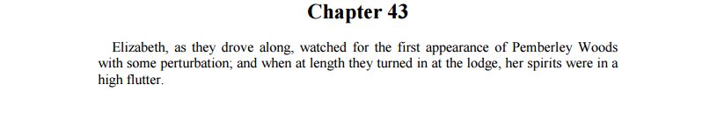
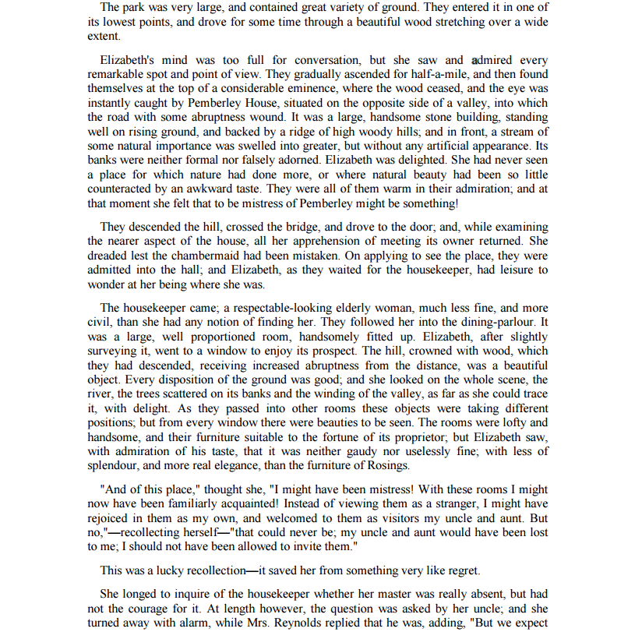
Story_Assistant
file:///D:/Github/TestPage/Test.html
Characters
Darcy
Location
Sequence
Elizabeth
Mr.Bennet
Locations
。Unknown
Netherfield Park
。Nether… Park
Woods
。Unknown
Others
。Forest
。Unknown
Choose Tags
。Nether… Park
Analyze Story
。Unknown
。Forest
。Unknown
。Nether… Park
。Unknown
。Forest

Slide 16
Story_Assistant
file:///D:/Github/TestPage/Test.html
Characters
Darcy
Location
Sequence
Elizabeth
Mr.Bennet
Locations
。Unknown
Netherfield Park
。Nether… Park
Woods
。Unknown
Others
。Forest
。Unknown
Choose Tags
。Nether… Park
Analyze Story
。Unknown
。Forest
。Unknown
。Nether… Park
。Unknown
。Forest

Slide 17

Story_Assistant
file:///D:/Github/TestPage/Test.html
。Forest | Chapter 43, line 1
Analyze
Characters
Darcy
Location
Sequence
Elizabeth
Mr.Bennet
Locations
。Unknown
Netherfield Park
。Nether… Park
Woods
。Unknown
Others
。Forest
。Darcy
。Unknown
Choose Tags
。Nether… Park
。Elizabeth
Analyze Story
。Unknown
。Mr. Bennet
。Forest
。Unknown
。Nether… Park
。Unknown
。Forest

Slide 18


Story_Assistant
file:///D:/Github/TestPage/Test.html
。Forest | Chapter 43, line 1 | Elizabeth
Analyze
。Darcy
Characters
。Elizabeth
Darcy
Location
Sequence
。Mr. Bennet
Elizabeth
Mr.Bennet
Locations
。Unknown
See
。Elizabeth
Remarkable spot
Netherfield Park
。Nether… Park
Woods
。Unknown
Others
。Forest
。Unknown
。Elizabeth
Dread
chambermaid
Choose Tags
。Nether… Park
Analyze Story
。Unknown
。Forest
。Unknown
。Nether… Park
。Unknown
。Forest
Have
。Elizabeth
Leisure

Slide 19
Story_Assistant
file:///D:/Github/TestPage/Test.html
。Forest | Chapter 43, line 1 | Elizabeth
Analyze
。Darcy
Characters
。Elizabeth
Darcy
Location
Sequence
。Mr. Bennet
Elizabeth
Mr.Bennet
。Unknown
Dread
Locations
。Elizabeth
chambermaid
Netherfield Park
。Nether… Park
Woods
。Unknown
Others
。Forest
。Unknown
Choose Tags
。Nether… Park
Analyze Story
。Unknown
。Forest
。Elizabeth
Have
Leisure
。Unknown
。Nether… Park
。Unknown
。Forest
。Elizabeth
Wonder
Where

Slide 20
Story_Assistant
file:///D:/Github/TestPage/Test.html
。Forest | Chapter 43, line 1 | Elizabeth
Analyze
。Darcy
Characters
。Elizabeth
Darcy
Location
Sequence
。Mr. Bennet
Elizabeth
Mr.Bennet
。Unknown
Dread
Locations
。Elizabeth
chambermaid
Netherfield Park
。Nether… Park
Woods
。Unknown
Others
。Forest
。Unknown
Choose Tags
。Nether… Park
has_possession
(E,P,T)
Analyze Story
。Unknown
Own
。Forest
。Elizabeth
Have
Leisure
。Unknown
Have
。Nether… Park
Possess
。Unknown
。Forest
。Elizabeth
Wonder
Where

Slide 21
Story_Assistant
file:///D:/Github/TestPage/Test.html
。Forest | Chapter 43, line 1 | Elizabeth
Analyze
。Darcy
Characters
。Elizabeth
Darcy
Location
Sequence
。Mr. Bennet
Elizabeth
Mr.Bennet
。Unknown
Dread
Locations
。Elizabeth
chambermaid
Netherfield Park
。Nether… Park
Woods
。Unknown
Others
。Forest
。Unknown
Choose Tags
。Nether… Park
Analyze Story
。Unknown
。Forest
。Elizabeth
Own
Leisure
。Unknown
。Nether… Park
。Unknown
。Forest
。Elizabeth
Wonder
Where

Slide 22
Story_Assistant
file:///D:/Github/TestPage/Test.html
。Forest | Chapter 43, line 1 | Elizabeth, Darcy
Analyze
。Darcy
Characters
。Elizabeth
Darcy
Location
Sequence
。Mr. Bennet
Elizabeth
Mr.Bennet
Darcy
Search
Elizabeth
Locations
。Unknown
Netherfield Park
。Nether… Park
Dread
chambermaid
Elizabeth
Woods
。Unknown
Others
。Forest
。Unknown
Choose Tags
。Nether… Park
Analyze Story
。Unknown
。Forest
Own
Leisure
Elizabeth
。Unknown
Darcy
Run
。Nether… Park
。Unknown
Wonder
Where
Elizabeth
。Forest
Darcy
Fall

Slide 23
Story_Assistant
file:///D:/Github/TestPage/Test.html
。Forest | Chapter 43, line 1 | Elizabeth, Darcy
Analyze
。Darcy
Characters
。Elizabeth
Darcy
Elizabeth
Darcy
。Mr. Bennet
Location
Sequence
Elizabeth
Mr.Bennet
Elizabeth See Remark…
Locations
。Unknown
Darcy Search Eliza…
。Nether… Park
Netherfield Park
Elizabeth Dread Chamb…
Woods
。Unknown
Others
。Forest
。Unknown
Choose Tags
。Nether… Park
Elizabeth Own Leisure
Analyze Story
。Unknown
Darcy Run
。Forest
Elizabeth Wonder Where
。Unknown
。Nether… Park
Darcy Fall
。Unknown
。Forest
Elizabeth Want Food
Darcy Have Food

Slide 24
Story_Assistant
file:///D:/Github/TestPage/Test.html
Analyze
。Darcy
Characters
。Elizabeth
Darcy
。Forest | Chapter 43, line 1
Location
Sequence
。Mr. Bennet
Elizabeth
Darcy
Mr.Bennet
Elizabeth
Locations
。Unknown
Elizabeth See
Netherfield Park
。Nether… Park
Darcy Search
Woods
。Unknown
Elizabeth Dread
Others
。Forest
。Unknown
Choose Tags
。Nether… Park
Elizabeth Own
Analyze Story
。Unknown
Darcy Run
Elizabeth Wonder
。Forest
。Unknown
Darcy Fall
。Nether… Park
Elizabeth Want …
。Unknown
。Forest
Darcy Have

Slide 25
Story_Assistant
file:///D:/Github/TestPage/Test.html
Analyze
。Darcy
Characters
。Elizabeth
Darcy
。Forest | Chapter 43, line 1
。Mr. Bennet
Location
Sequence
Elizabeth
Mr.Bennet
Elizabeth
Darcy
Locations
。Unknown
Eliza..
Darcy
Netherfield Park
。Nether… Park
Eliza..
Woods
。Unknown
Eliza..
。Forest
Darcy
Others
Eliza..
。Unknown
Darcy
Choose Tags
Eliza..
。Nether… Park
Analyze Story
。Unknown
Darcy
。Forest
。Unknown
。Nether… Park
。Unknown | Chapter 43, line 75
。Unknown
。Forest
。Neitherfield | Chapter 43, line 185

Slide 26


Story_Assistant
file:///D:/Github/TestPage/Test.html
Characters
Darcy
Analysis
Location
Sequence
Elizabeth
Mr.Bennet
Elizabeth
Darcy
Locations
。Unknown
Netherfield Park
。Nether… Park
Woods
。Unknown
Others
。Forest
Woods
。Unknown
Choose Tags
。Nether… Park
。Unknown
Analyze Story
Neth… Park
。Forest
。Unknown
Unknown
。Nether… Park
。Unknown
。Forest
Scene100
Scene101
Scene102
Scene103
Scene104
Scene105
Scene106

Slide 27
Story_Assistant
file:///D:/Github/TestPage/Test.html
Analyze
。Darcy
Characters
。Elizabeth
Darcy
。Forest | Chapter 43, line 1
。Mr. Bennet
Location
Sequence
Elizabeth
Mr.Bennet
Elizabeth
Darcy
Locations
。Unknown
Eliza..
Darcy
Netherfield Park
。Nether… Park
Eliza..
Woods
。Unknown
Eliza..
。Forest
Darcy
Others
Eliza..
。Unknown
Darcy
Choose Tags
Eliza..
。Nether… Park
Analyze Story
。Unknown
Darcy
。Forest
。Unknown
。Nether… Park
。Unknown | Chapter 43, line 75
。Unknown
。Forest
。Neitherfield | Chapter 43, line 185

